Slide 1

Travel Explorer Make Memories Around The World
Saran Akkiraju - 2
Pallavi Desai - 62
Neeraj Padarthi - 37
Harish Tata - 50

Slide 2
Objective:
To create an application which gives a better travel plan to the user based on his interests, budget and duration of the trip.
Targeted Users:
Anyone who is looking for a best travel plan

Slide 3






Existing Applications
Google Trips
TripAdvisor
Triplt
Skiplagged
MakeMyTrip
Yatra

Slide 4


Unique Features
We consider below for making a better plan.
Budget
Interest of the user

Slide 5
Features
Interest and User review based sorting
User customized plan
Search History
Day wise plan (Budget and shortest path)
View Day wise plan

Slide 6
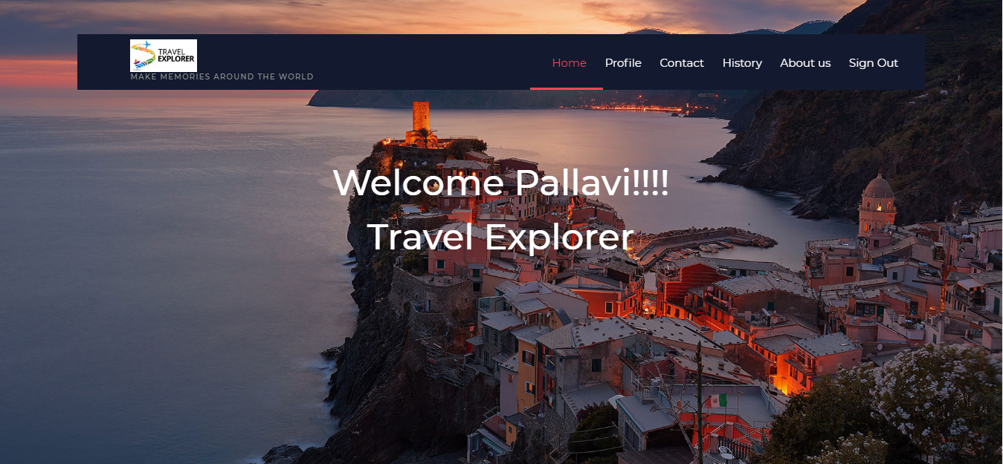
Home Page

Slide 7
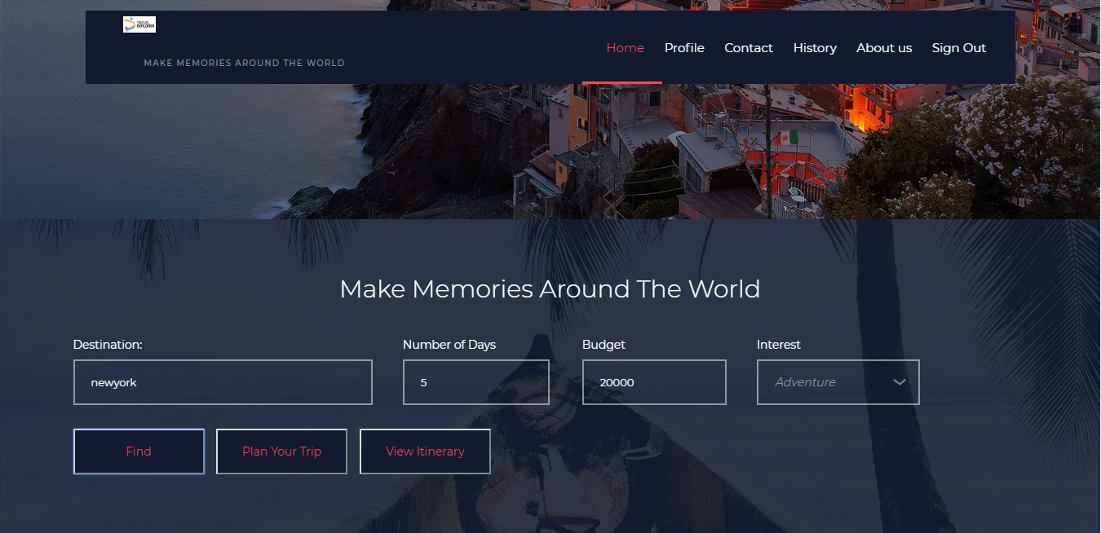

Slide 8
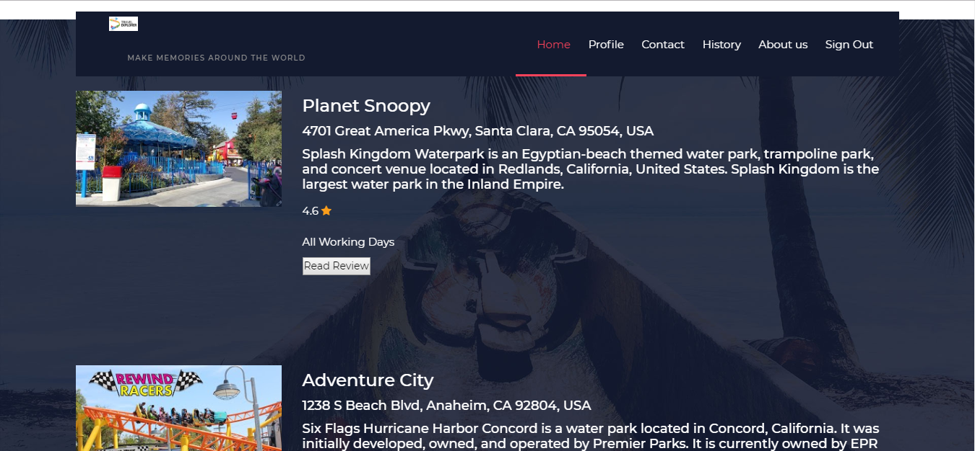
Interest and User review based sorting

Slide 9
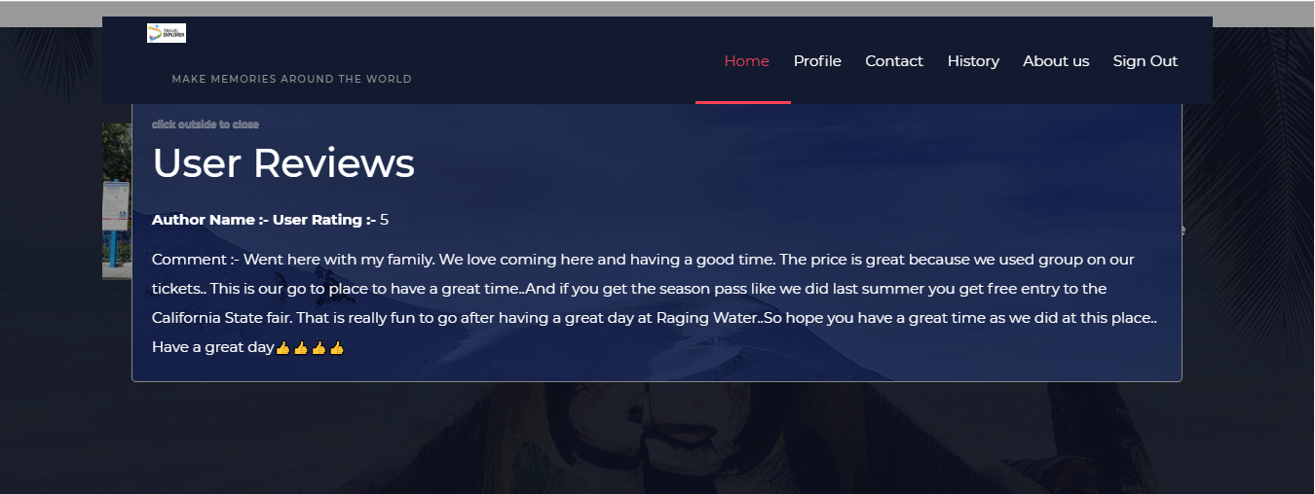
User Review

Slide 10
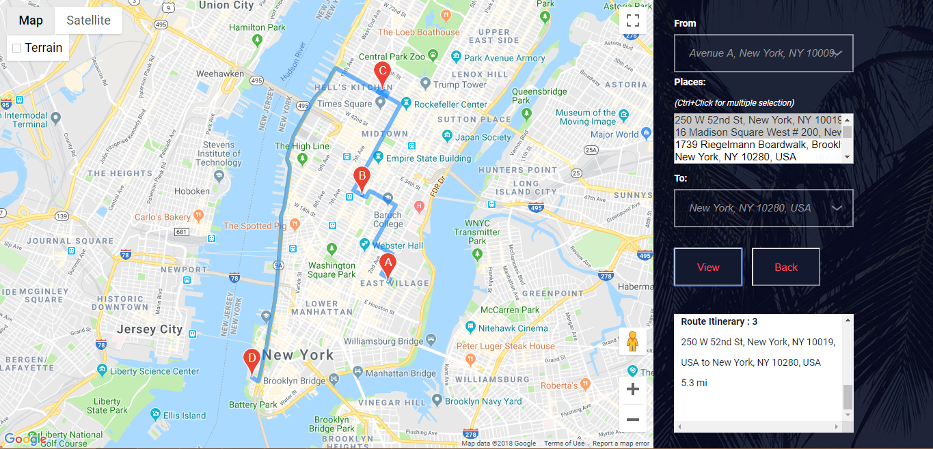
User customized plan

Slide 11
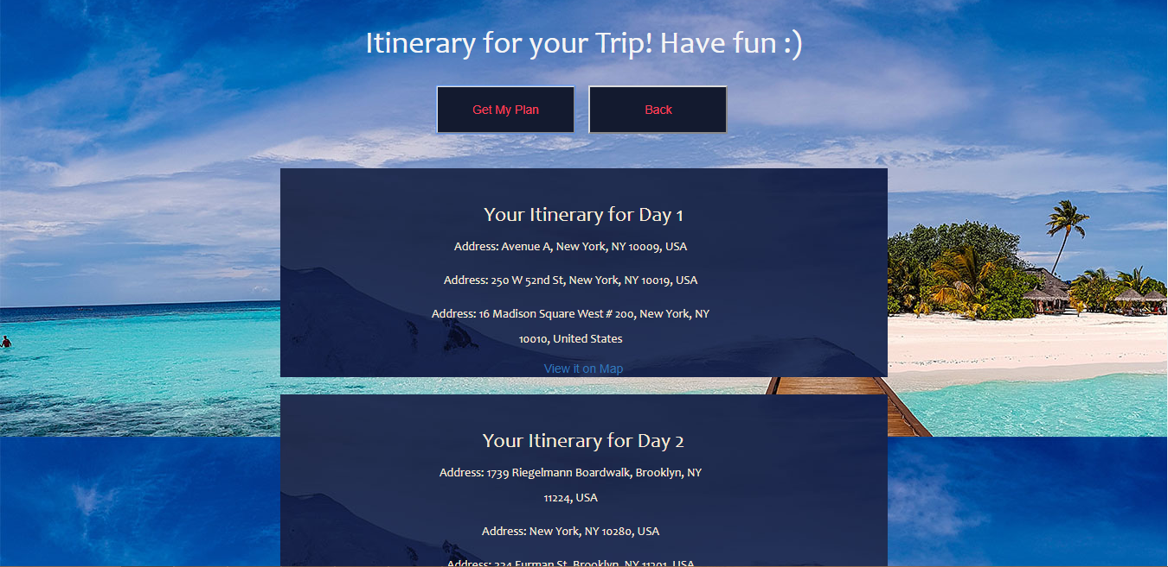
Day wise plan

Slide 12
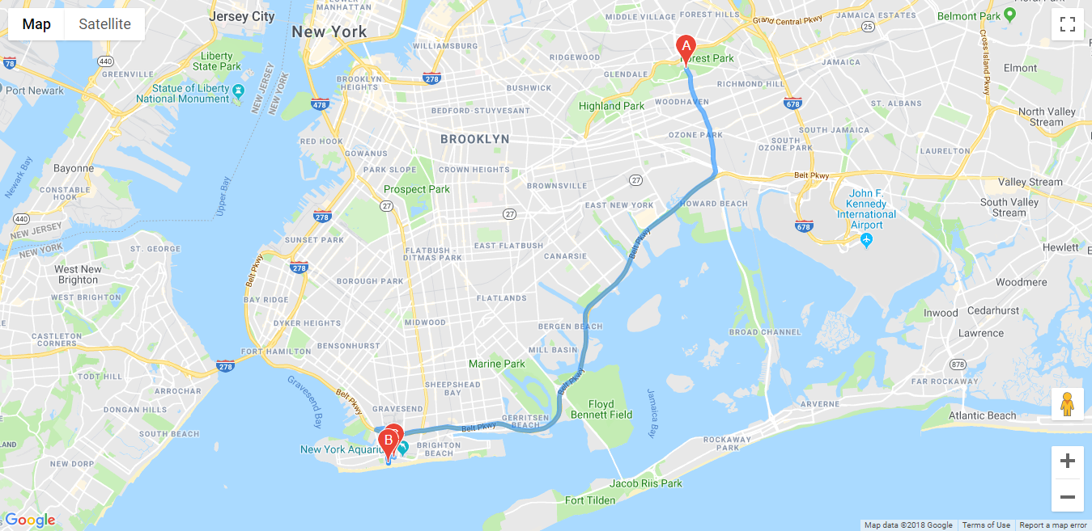
View Day wise plan

Slide 13
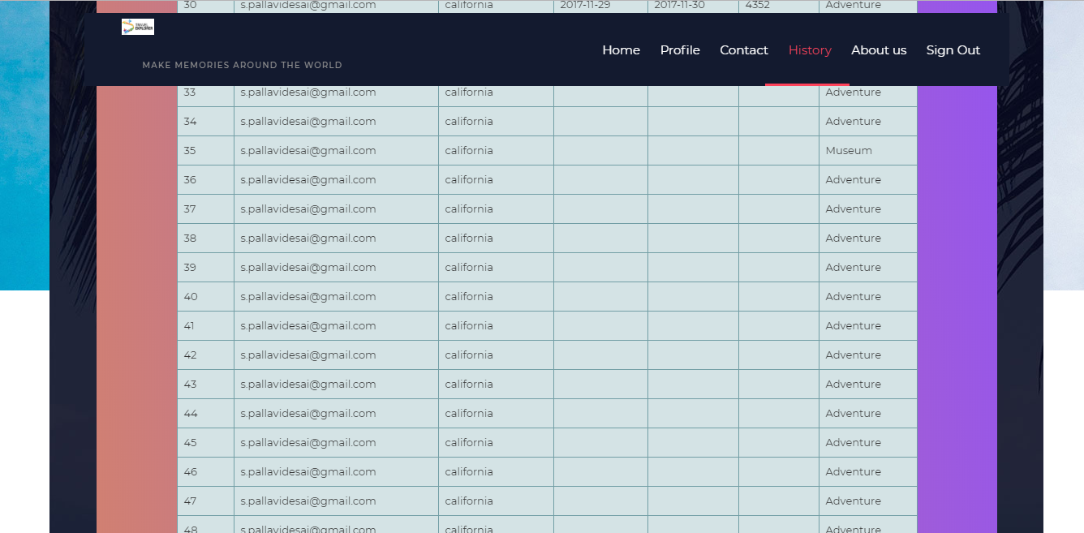
Search History

Slide 14
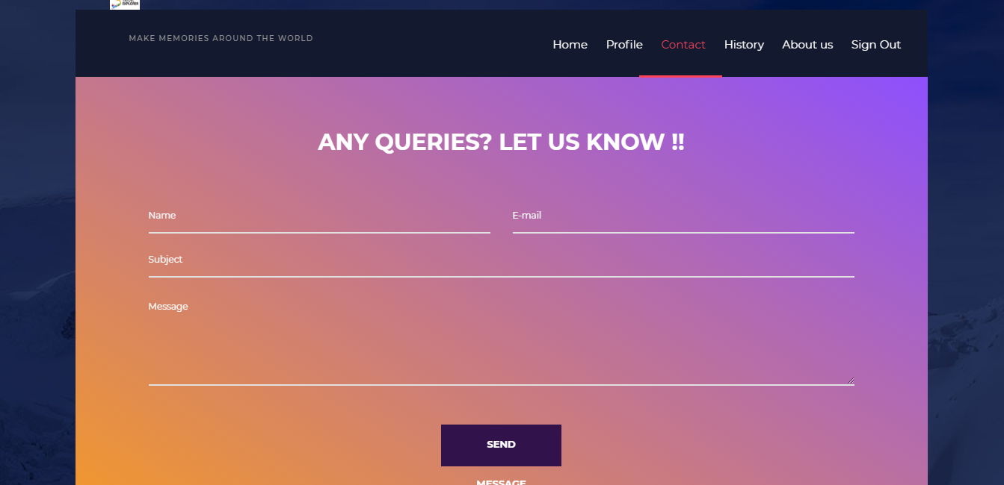
Contact Us

Slide 15
APIs Used
Google Place Search
Google Place Id
Knowledge Graph Search
Google Maps

Slide 16
Future Enhancements
Taking multiple interests into consideration
Giving an option to chose mode of transportation
Budget estimates including hotel, mode of transportation
Provide links for coupon codes for visiting a place

Slide 17
References
https://developers.google.com/places/web-service/search
https://developers.google.com/places/web-service/place-id
https://developers.google.com/places/web-service/photos
https://developers.google.com/maps/documentation/javascript/tutorial
https://developer-tripadvisor.com/content-api/
http://www.budgetyourtrip.com/api/
https://get.google.com/trips/
https://developers.google.com/knowledge-graph/

Slide 18


Slide 19


